Slide 1


Halil Ibrahim Uluoglu

Slide 2

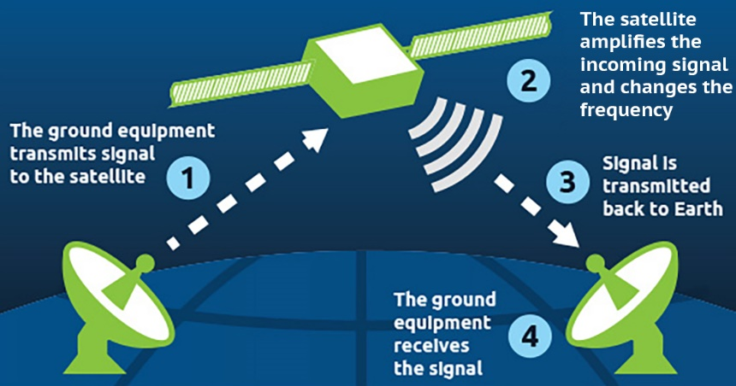
Problem Document
Requirement
Shall allow experts on Earth who are not physically in the same space to collaborate and develop instructions for astronauts
Author
Halil Ibrahim Uluoglu, UEF
Description
Giving instruction from Earth to astronauts is one of the most important mission during Mars exploration. It can be considered 4 steps to manage this problem.
Understanding what is the problem from astronauts
Considering that astronauts are not experts in the problem, they may not know technical details to describe for experts on Earth. So, it can cause some extra problems except just understanding the main problem
Solving the problem with experts on Earth
Even tiny problems at the Mars must always considerate as fatal problems because of Mars conditions. Experts must be gathered very quickly to save time and they must have a working single exact solution in order not to cause misunderstandings. Experts should have as the same environment as astronauts have.
Transferring solution to astronauts
Communication is a very challenging situation even two places on Earth because of weather conditions, it may disrupt. Also, antennas on Earth and satellite of astronauts must lock at the same angle during transferring messages considering that satellite and Earth spin duration and speed. Therefore, communication channels should be solid and messages should be pure.
Apply solution to the problem
Astronauts might have just one chance to apply the solution. So, the solution package should cover all significant details with basic understanding. The package also should include the purpose of that movement hence astronauts understand information about what is happening also they can interfere in an emergency
Simulation/Measurement
Prepare same condition as astronauts have before the problem
Simulate a communication method and test with same difficulties
Instruction with Keywords
References
https://spaceplace.nasa.gov/sound-cone/en/
https://spaceplace.nasa.gov/dsn-antennas/en/
https://www.nasa.gov/sites/default/files/files/NASA-Solve-FS.pdf

Slide 3
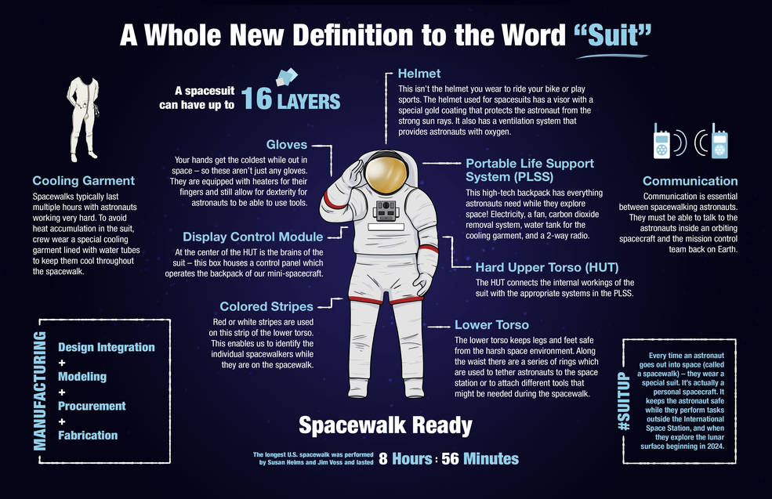
Problem Document
Sub-problem
Solution Instruction Developing
Author
Halil Ibrahim Uluoglu, UEF
Description
Even tiny problems at the Mars must always considerate as fatal problems because of Mars conditions. Solutions which developed on Earth may not fit unique Mars conditions. Mars contains extreme low temperature, no breathable air, high risk radiation and changeable magnetic fields. Moreover, radiation and magnetic field is very dangerous for computers in space crafts. When radiation collides with electronic circuit, they can cause spurious currents around the craft or even burn out computer chips. Changeable magnetic field can induce the content of memory cells so, it may cause different bits in memory. It may cause even collapse.
Experts must be gathered very quickly to save time and they must have a working single exact solution in order not to cause misunderstandings. So, while experts developing a solution, they should consider every possibility that may happen. Some steps may cause problems not in the moment but during the time.
Experts and astronauts can not make a video conference every time due to communication difficulties. In order to come up with a solution, they should have to access all specific, tiny details. So, they should have the same environment as astronauts have.
For these reasons, they need to prepare well-designed instructions that both experts and non-experts can understand/apply without any difficulties. Instruction should contain visual content for better understanding, some technical details for future perspective, flow charts for algorithmic solutions and also the purpose of that movement hence astronauts understand information about what is happening also they can interfere in an emergency.
Simulation/Measurement
Prepare same condition as astronauts have before the problem
Simulate a communication method and test with same difficulties
Instruction with Keywords
References
https://www.esa.int/Science_Exploration/Space_Science/Extreme_space/Surviving_extreme_conditions_in_space
https://www.cobblestonelearning.com/10-design-tips-instructional-designers/
https://www.nasa.gov/feature/spacewalk-spacesuit-basics

